Slide 1
ENSE 496ab, Milestone 1
Mudsnake FC
Xiaojie Chen, Connor Meredith, Zain Chowdhary, Jinpeng Chen, Demitri Kourles, Shuaihao Zhao
Sept. 27, 2018

Slide 2
Team introductions
Introducing our team members
Xiaojie Chen, Connor Meredith, Zain Chowdhary, Jinpeng Chen, Demitri Kourles, Shuaihao Zhao
What’s your team name?
Mudsnake FC
What project you were assigned
Weekend Warriors

Slide 3
Review & analysis
Comment on the readability and usability of the GitHub content for the team’s project you were assigned
Grammar made some parts difficult to understand
Context Diagrams confusing
What do you like about the team’s design/design choices
Similarities to Facebook (good for user familiarity)
Profile preview feature

Slide 4
Review & analysis
What do you dislike about the team’s design/design choices?
No User Profile Page
No Option for email profile recovery
Daily email rundown (Give a user options)
What did the users say (if anything) that may correspond to your team’s feelings?
Users liked the progress bar on ideas indicating the idea status
Users liked that the landing page is the general ideas feed
Users had difficulty finding the “abandon” button on ideas

Slide 5
Revisioning
Discuss any ideas you have for extending/revisioning the design
Add status summary to idea posts
Link to retrieve forgotten credentials (instead of contacting IT immediately)
Dedicated search results view (instead of just filtering the general ideas feed)

Slide 6
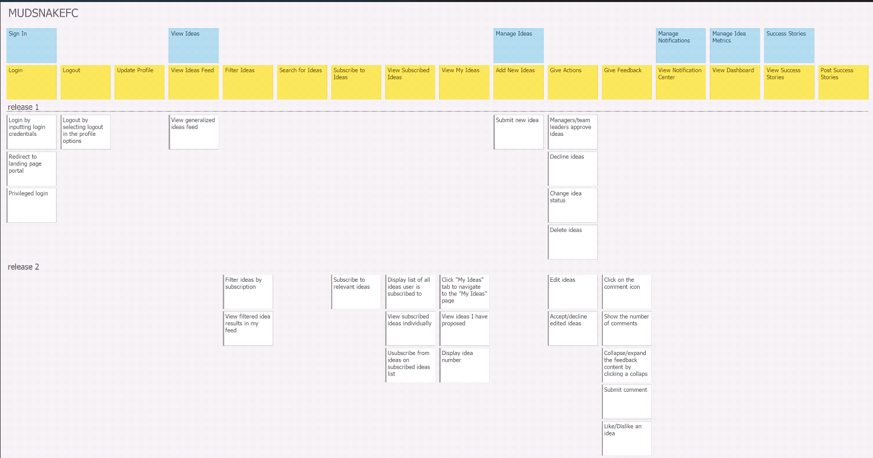
User Story Map

Slide 7
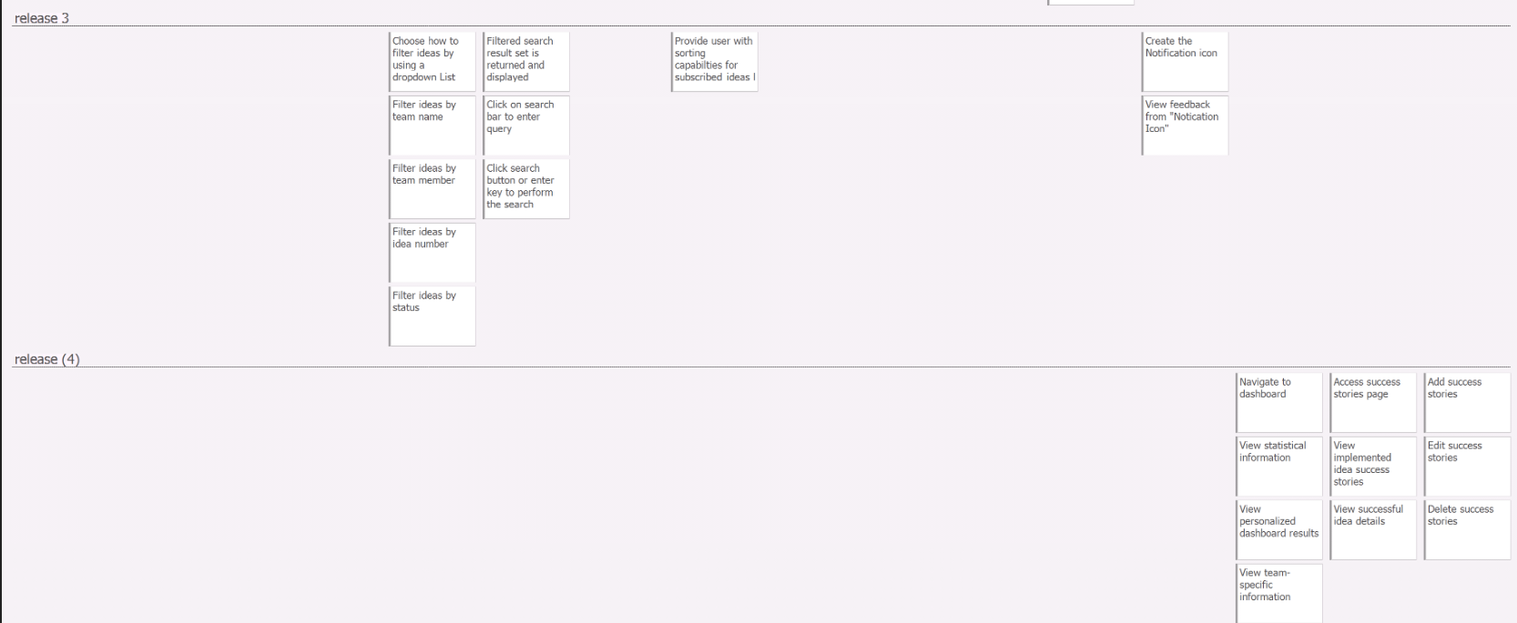
User Story Map

Slide 8
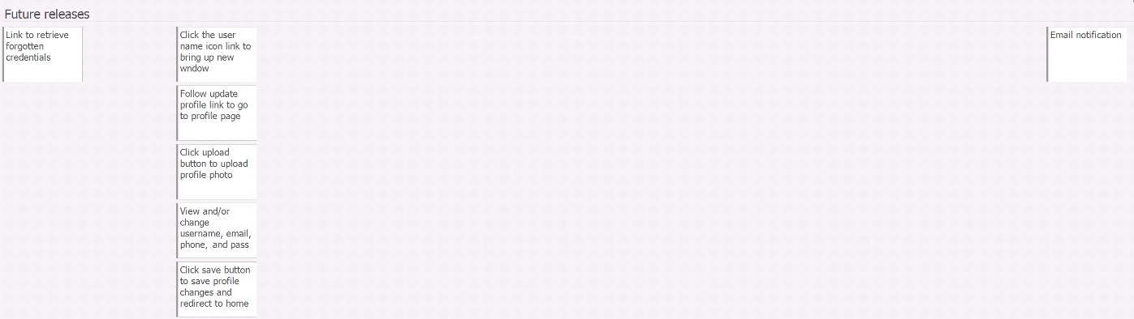
User Story Map

Slide 9
Release 1
Login / Logout functionality
Not overly important in itself, but this is a logical starting point and getting this completed will allow us to tackle the other features with more ease
Submit an idea
This is a core feature
Approve / Decline / Change Status of Idea
All ideas must go through this phase
View idea feed
This feed will serve as the home page

Slide 10
Release 2
Provide idea feedback (comments and likes)
Idea feedback will likely play a role in deciding whether or not an idea is approved
Comments and like can be used to show support for an idea
Comments can also be used to discuss an idea and clarify any confusion surrounding an idea
Subscribe / Unsubscribe from ideas
Allows users to follows ideas that they support or are interested in
View Subscribed Ideas
Allows users to see subscribed ideas and filter out ideas that they do not care about

Slide 11
Release 2
Edit idea
Ideas submitted may need to be modified
View my ideas
Users need an easy way to view ideas submitted by themselves as these are likely the ideas that are most important to each user
Filter ideas by subscription
The majority of filtering and searching will be completed in release 3. We will only complete this filtering in release 2 since we are already implementing the idea subscription features in this release

Slide 12
Release 3
Searching ideas
This will provide users with a mechanism for finding ideas without having to use one of the generic idea feeds
Receive Notifications
This will allow user to know when certain events have occured
Please note that this does not include email notification in this release

Slide 13
Release 3
Filter ideas
This will allow users to filter ideas from search results and from their subscribed ideas feed
Users will be able filter ideas based off the following criteria:
Status
Team name
Team member name
Idea number

Slide 14
Release 4
View dashboard
This will allow the user to see some useful analytics relating to ideas that they are involved with
Dashboard will show both information that is personalized as well as team-specific information
Posting success stories
This will give users the ability to create, edit, and delete success stories
View success stories
Users will be able to see all the success stories posted
This page will be reserved for successful ideas

Slide 15
Future Releases
Update profile
Allows user to update contact information
Also allows user to upload picture for profile
Nice feature, but not all that important
Forgot my password link for failed login
Clicking this link should start chat with help desk
Email notifications
This feature would provide user with emails for notifications
Useful, but most notifications likely are not urgent enough that email is necessary
Worst case scenario, users will just have to login if they wish to view their notifications

Slide 16
Group reflection
How did you feel about this milestone? What did you like about it? What did you dislike?
Simple and straightforward
Comfortable creating USM’s as we have done so in previous semesters
What did you learn about yourself as you collaborated and worked through this milestone?
We learned that different people have varying design intuitions allowing for variety of input
How will you use what you have learned going forward?
We will use the USM we have created to guide the project going forward. In the future, we will use this experience in the planning stages of new projects.
What “stuff & things” related to this milestone would you want help with?
Nothing much as we did not need to make major changes to the initial plan

